Slide 1



Slide 2

PRESENTED BY:
Batch – 98 (MICROSERVICES) :-
Naveen Kamatham (Emp Id: 6648 )
Renikunta Ganesh (Emp Id: 6618)
Shesha Thallu (Emp Id: 6619)
Adinarayana Kuruva (Emp Id: 6617)

Slide 3

INTRODUCTION :
The main aim of the project is to manage employees.
The employee details are displayed, leaves and salaries of employees are managed .

Slide 4
PROBLEM STATEMENT :
The problem definition for designing the system is to maintain data of employee, to make easy controlling of employees and employee data .

Slide 5
ARCHITECTURE
Application
Dockerization
AWS

Slide 6







TECHNOLOGIES
spring boot MVC
Angular
HTML
CSS
MYSQL
Docker
AWS

Slide 7
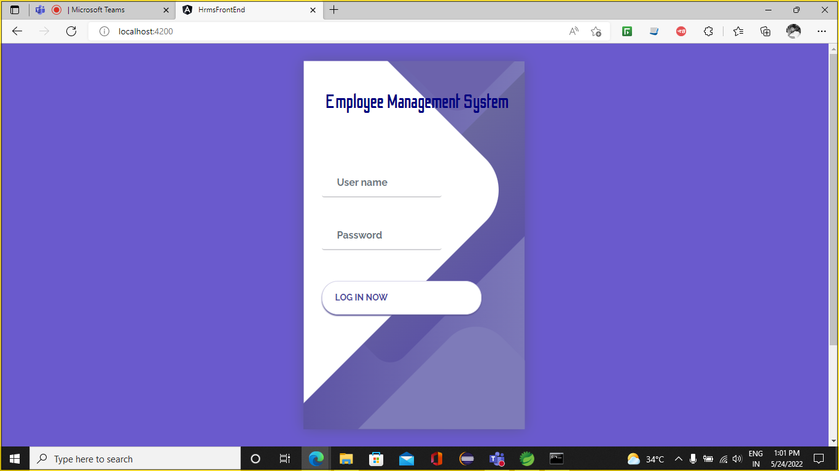
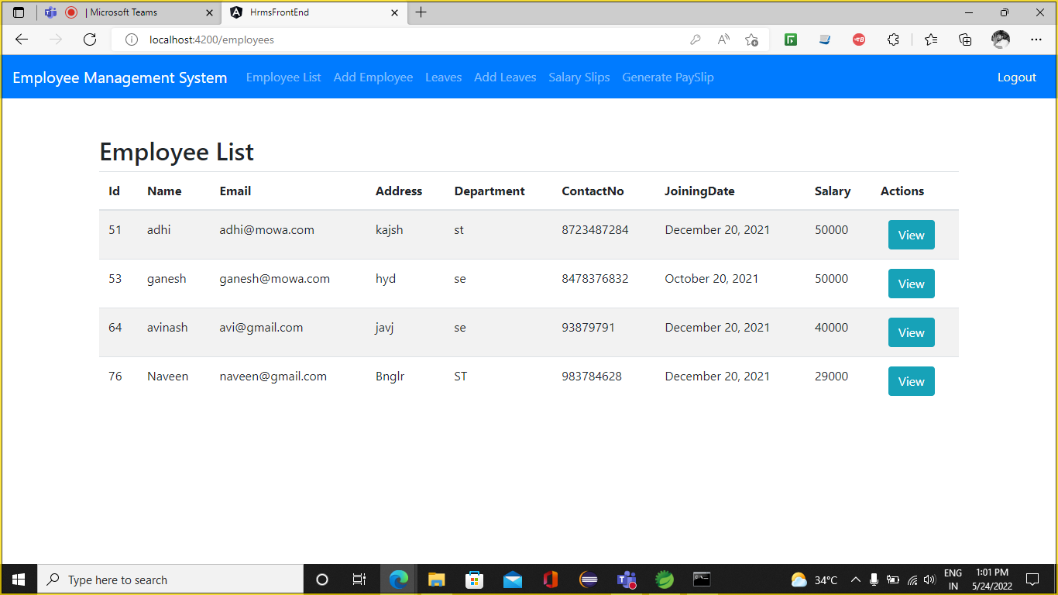
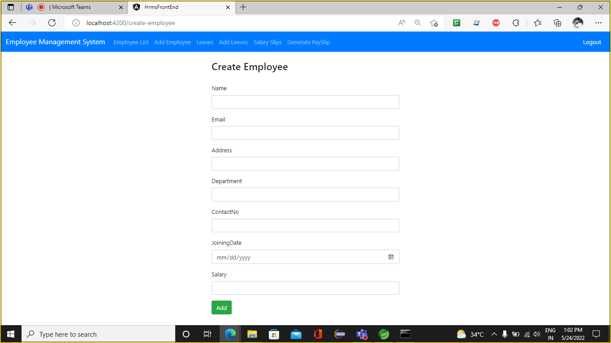
RESULTS

Slide 8
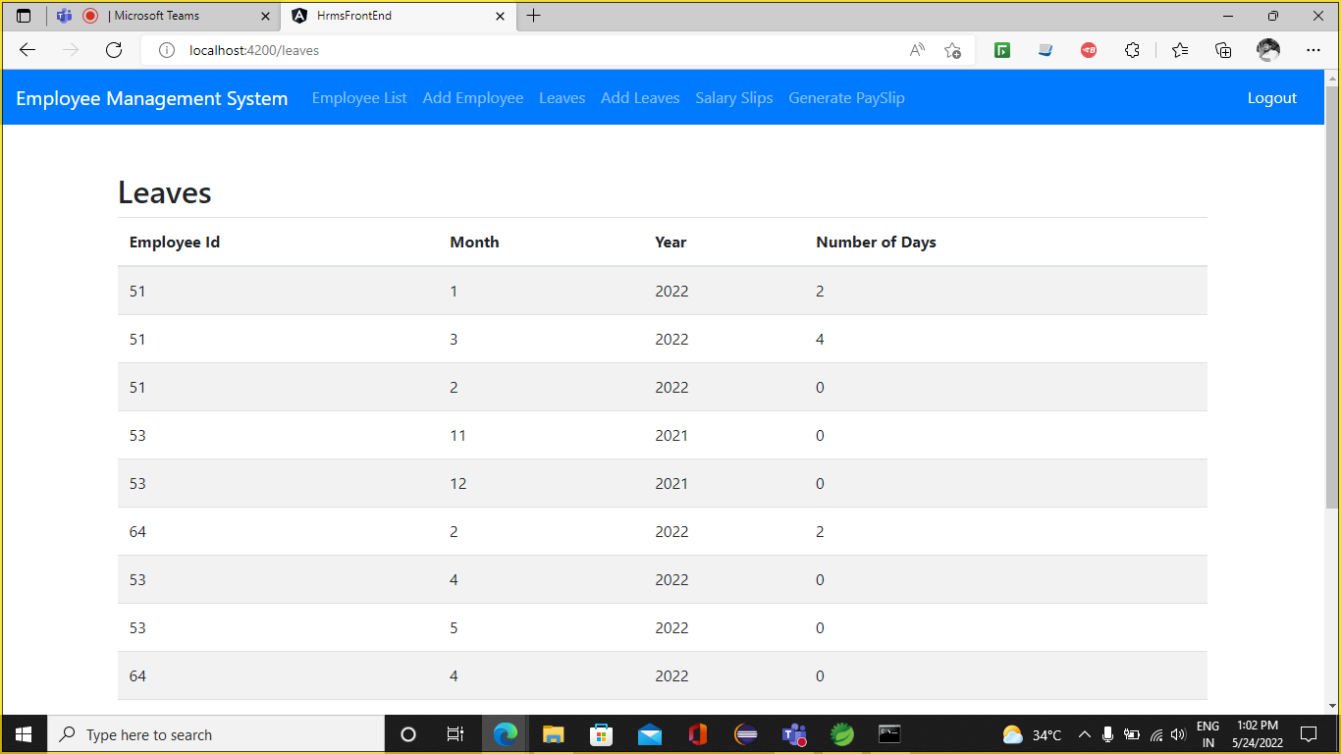
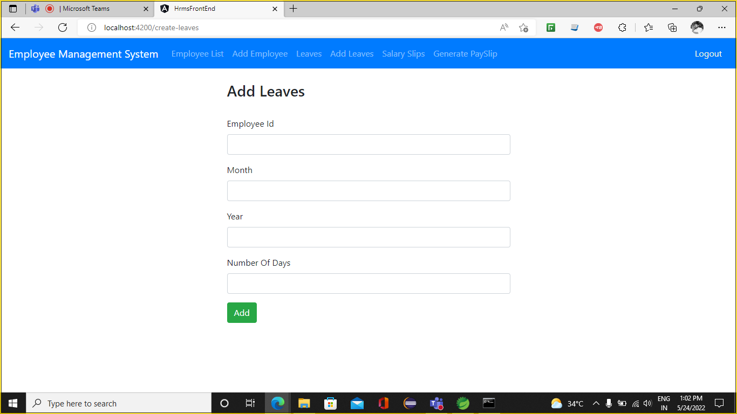
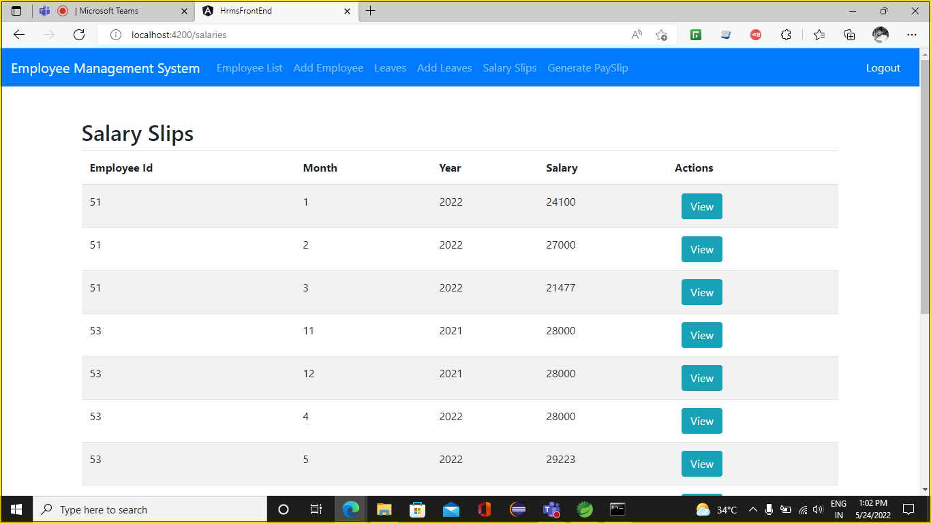

Slide 9
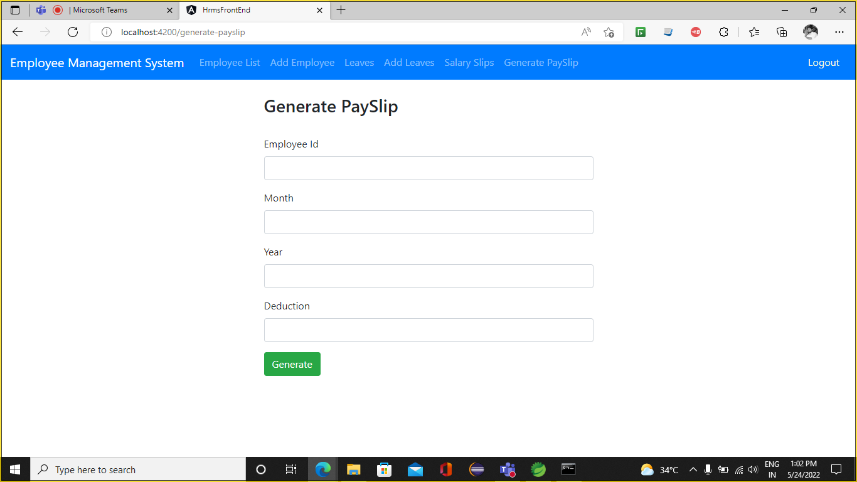
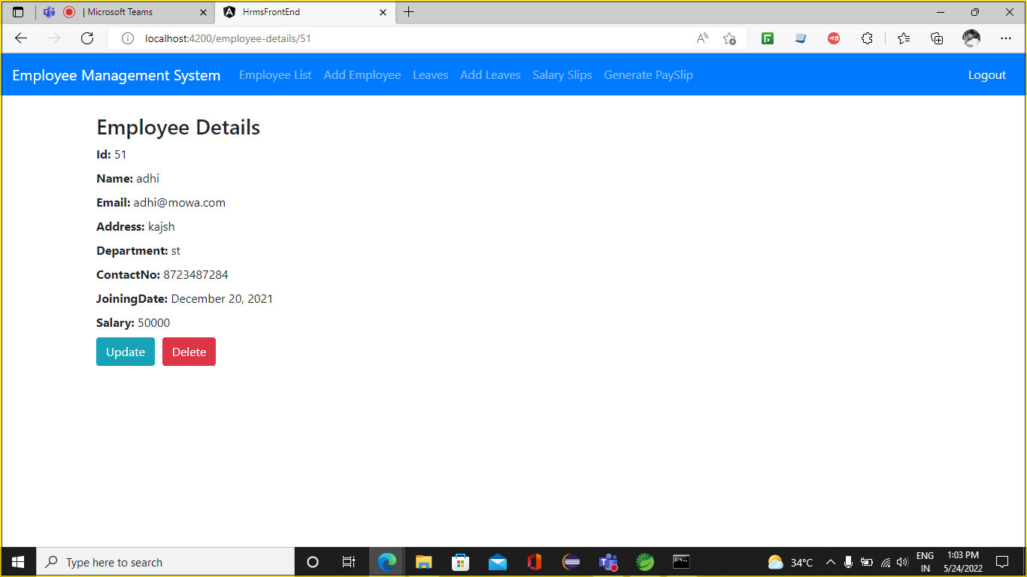
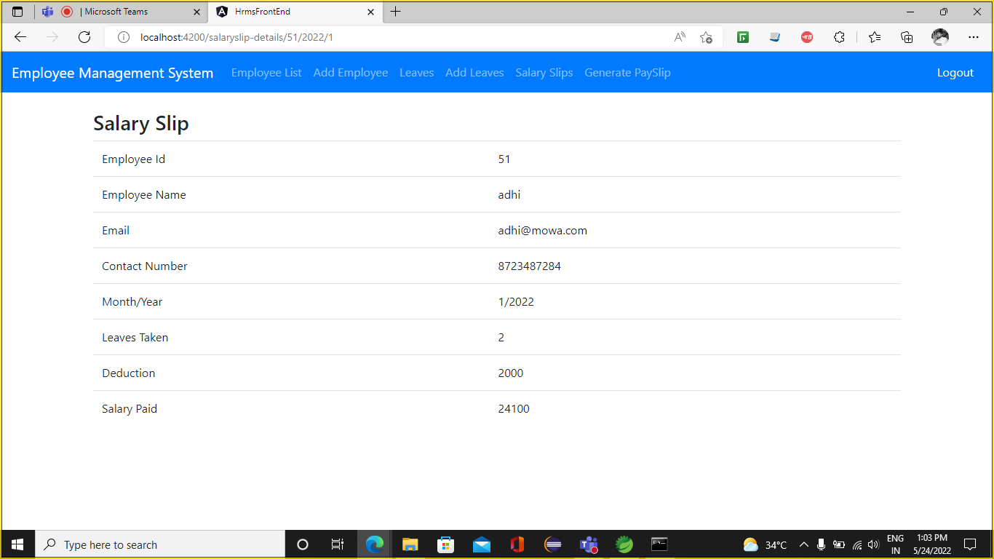

Slide 10



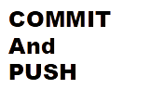



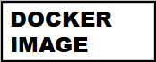
DEPLOYMENT

Slide 11
CONCLUSION :
Employee Management System is a web application where the employee information is managed.
Employee information includes adding leaves and generating salary slips.

Slide 12
THANK YOU

